Slide 1
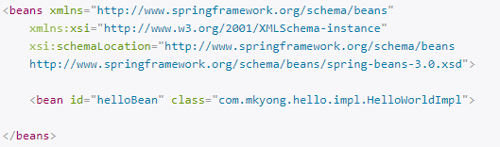
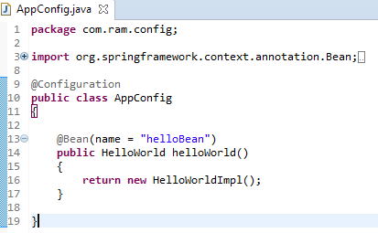
Spring JavaConfig example
Since Spring 3, JavaConfig features are included in core Spring module, it allow developer to move bean definition and Spring configuration out of XML file into Java class.
But, we are still allow to use the classic XML way to define beans and configuration, the JavaConfig is just another alternative solution.
See the different between classic XML definition and JavaConfig to define a bean in Spring container.
Spring XML file
Equivalent configuration in JavaConfig

